Slide 1

Introducing React Components
React components are the building blocks of modern web applications. They encapsulate UI elements, logic, and state, allowing for modular and reusable code that enhances development efficiency and maintainability.
P.Venkata sai krishna
22H51A0550
CSE-D

Slide 2

What are React Components?
1
Modular Units
2
Encapsulation
React components are self-contained, reusable pieces of a user interface that can be composed together to create complex applications.
Each component manages its own state, props, and rendering logic, keeping concerns isolated and improving code organization.
3
Hierarchy
Components can be nested, with parent components passing data down to child components through props.

Slide 3
Benefits of Modular Components
Reusability
Testability
Scalability
Components can be reused across multiple parts of an application, reducing development time and improving consistency.
Isolated components are easier to test individually, leading to more reliable and maintainable code.
The modular nature of components allows large applications to be built and scaled more effectively.

Slide 4
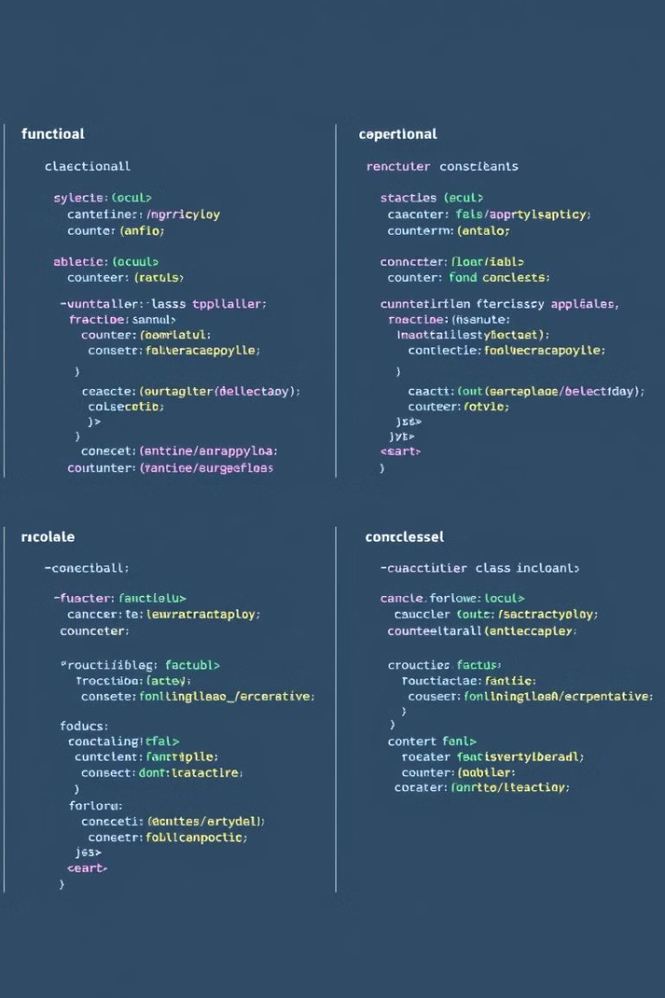
Functional vs. Class Components
1
Functional Components
Simpler syntax, use hooks to manage state and lifecycle, better performance and maintainability.
2
Class Components
Provide more flexibility, access to lifecycle methods, and the ability to manage state independently.
3
Evolving Landscape
Functional components with hooks are increasingly the preferred approach in modern React development.

Slide 5

Creating a Basic Component
Syntax
Rendering
Components can be defined as either functions or classes, each with their own syntax and capabilities.
Components return JSX, a syntax extension for JavaScript that allows mixing HTML-like code with JavaScript.
Naming
Imports/Exports
Component names should be descriptive and consistent, following best practices for React naming conventions.
Components are organized and shared by importing and exporting them throughout the application.

Slide 6

Lifecycle Methods in Components
1
Mounting
Methods called when an instance of a component is being created and inserted into the DOM.
2
Updating
Methods called when a component is being re-rendered due to changes in props or state.
3
Unmounting
Methods called when a component is being removed from the DOM.

Slide 7



Styling React Components
CSS Modules
Styled Components
Emotion
Scoped CSS that avoids naming conflicts and keeps styles encapsulated within components.
A library that allows writing CSS-in-JS, integrating styles directly within components.
A flexible library for writing CSS-in-JS, offering a balance of performance and developer experience.

Slide 8

Best Practices for Component Design
Single Responsibility
Components should have a clear, well-defined purpose and do one thing well.
Composition over Inheritance
Favor composing smaller components together over inheriting from a base component.
Unidirectional Data Flow
Data should flow down the component tree from parent to child, not the other way around.
Separation of Concerns
Separate presentational (UI) and container (logic) components for better maintainability.

Slide 9


